Slide 1
IOT BASED IRRIGATION SYSTEM FOR SMART FARMING

Slide 2
ABSTRACT
This project proposes agricultural area monitoring using Various sensors and Arduino nano controller.
The WIFI module is used to send the data’s to the land Owner.
The IOT is used to control the Pump motor and Cooling light.
This project is implemented using Arduino nano micro controller.
And also Automate the Distribution System for Canal Irrigation System

Slide 3
OBJECTIVE
To monitor the agricultural area with the help of various sensors.
To send the Humidity and light level to the owner using WIFI module.
To control the Pump motor and light using IOT.

Slide 4
LITERATURE SURVEY
Name of the Paper | Name of Publication | Author | Year | Methodology | Demerits
IoT based smart crop-field monitoring and automation irrigation system | International Journal on Inventive Systems and Control | R. Nageswara Rao ; B. Sridhar Li et al | 2018 | Machine learning algorithm | High computational cost
Mobile integrated smart irrigation management and monitoring system using IOT | International Journal on Communication and Signal Processing | S. Vaishali ; S. Suraj et al | 2017 | Raspberry pi technique | Sensor has damaged not managing

Slide 5
LITERATURE SURVEY
Name of the Paper | Name of publication | Author | Year | Methodology | Demerits
Factory automation and irrigation control in an IoT environment | International Journal on Control and Engineering | Kamel Ammour, Xiatian Zhu Li et al | 2018 | Internet of Things technique | High computational cost
Distant Monitoring and Controlling of Solar Driven Irrigation System through IoT | International Journal on Inventive Systems and Control | M.Mahalakshmi ; S. Priyanka et al | 2018 | Message Queue Telemetry Transport technique | Bad weather condition this system has not detected

Slide 6
EXISTING SYSTEM
Servo motors | 1,00,000
Wi-fi module | 80,000
Camera module | 1,80,000
Arduino full setup | 2,00,000
Sensors with connectors | 60,000
Solar powered panels & wind energy | 2,00,000
Pipe and gate walls | 1,20,000
Sprinklers with water pipes | 60,000
Connecting wires | 1,00,000
motors | 2,00,000
TOTAL | 13,00,000

Slide 7
DRAWBACKS
System response slow.
Micro controller operating frequency is very low.
Needs additional interfaces

Slide 8
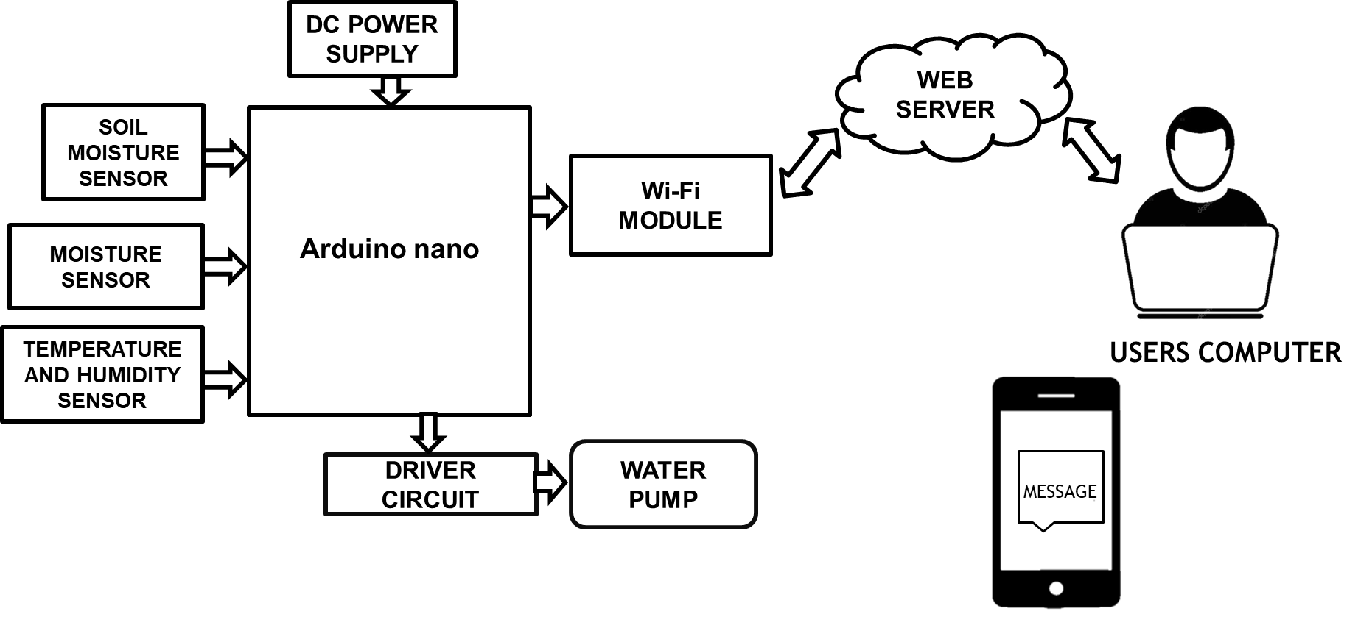
PROPOSED SYSTEM BLOCK DIAGRAM

Slide 9
METHODOLOGY
An IoT based irrigation system aims to utilize the features of embedded system to make agriculture simple.
Having sensors connected with controller, the system reads the soil moisture, temperature and electrical conductivity of the soil and then the sensed data are processed in the controller.
The Arduino nano microcontroller is the decision maker of this system. It checks for moisture value and the temperature and sends this data to a server.
The remote operator can control the operations of pumps and valves for irrigation
Also Automate the Distribution System for Canal Irrigation System

Slide 10
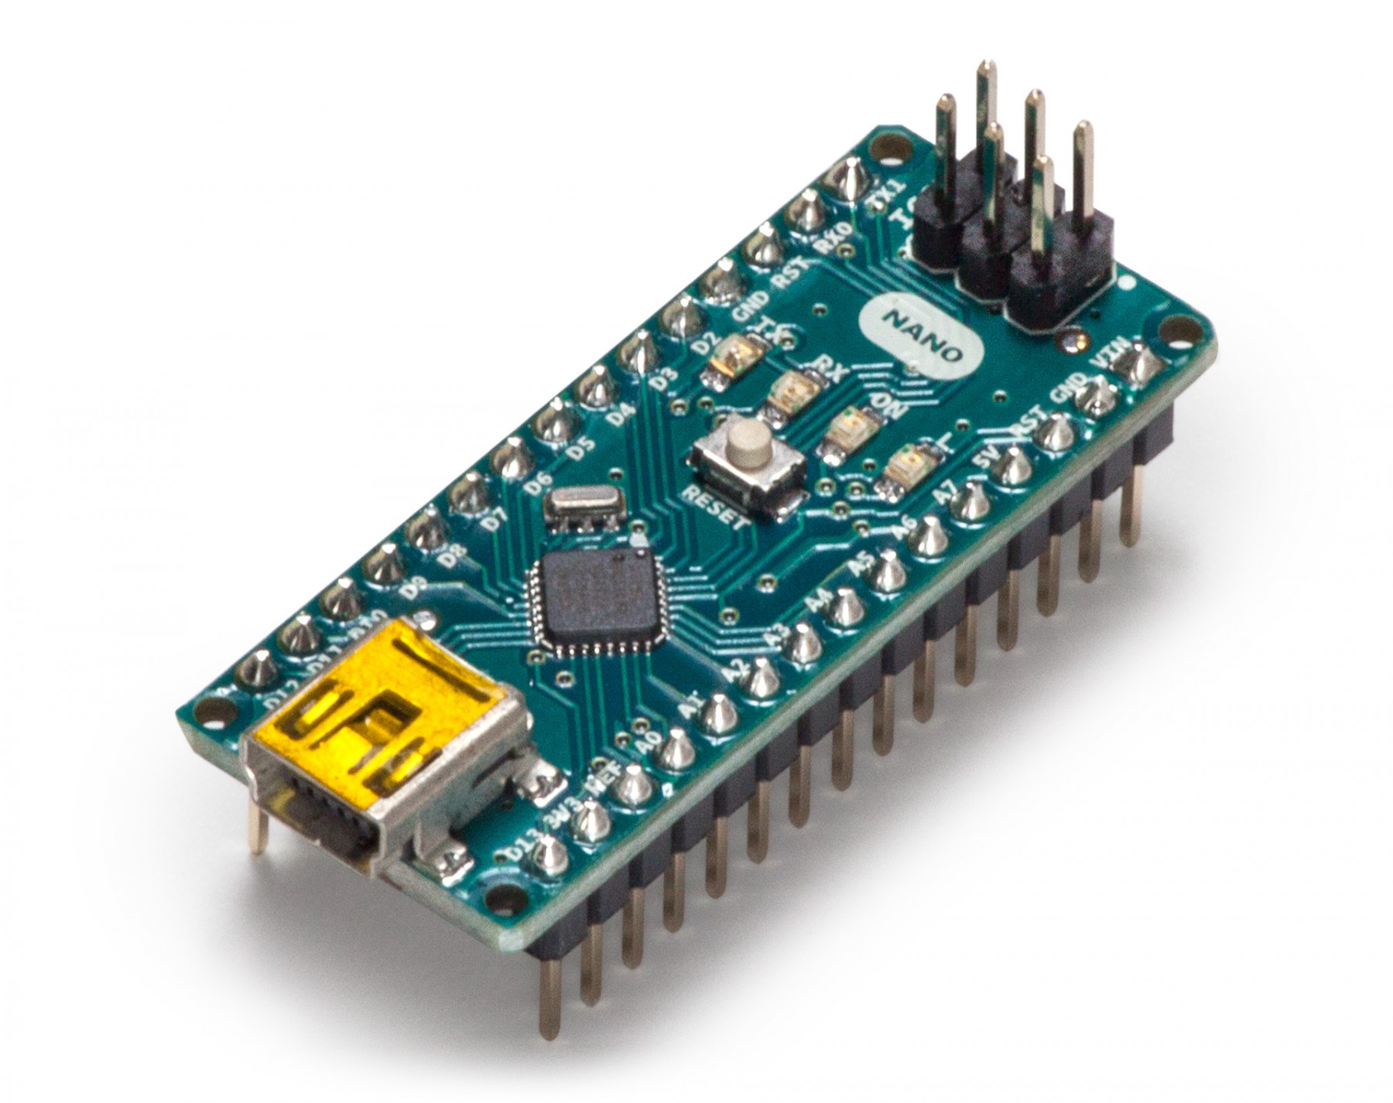
ARDUINO nano MICROCONTROLLER
Arduino is an open source electronics platform based on easy to use hardware and software.
It is a microcontroller board based on the ATmega328.
It has 14 digital input/output pins, 6 analog inputs, a 16 MHz ceramic resonator, a USB connection, a power jack, an ICSP header, and a reset button.
It contains everything needed to support the microcontroller; simply connect it to a computer with a USB cable or power it with a AC-to-DC adapter or battery to get started.

Slide 11
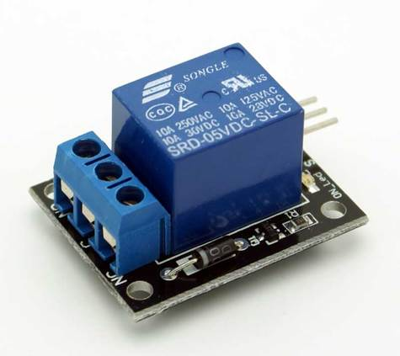
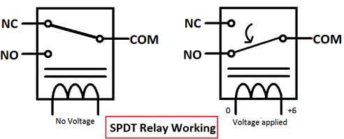
RELAY MODULE
A relay is an electrically operated switch that can be turned on or off, letting the current go through or not, and can be controlled with low voltages
NC (Normally Closed): the normally closed configuration is used when you want the relay to be closed by default, meaning the current is flowing unless you send a signal from to the relay module to open the circuit and stop the current.
NO (Normally Open): the normally open configuration works the other way

Slide 12
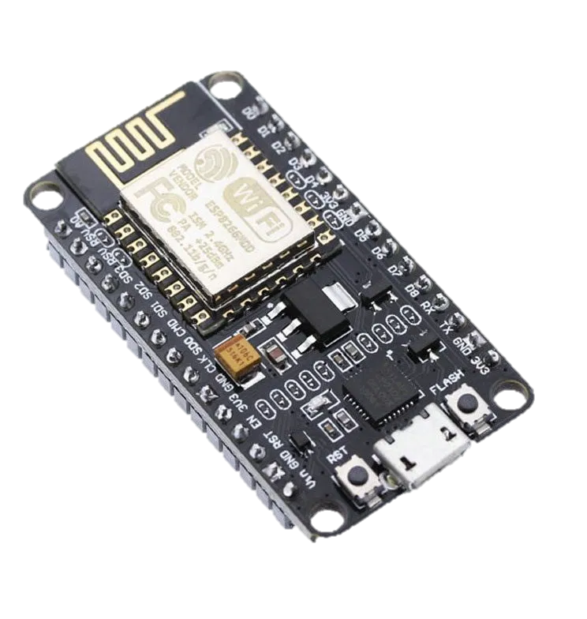
Wi-Fi MODULE
The ESP8266 WiFi Module is a self contained SOC with integrated TCP/IP protocol stack that can give any microcontroller access to your WiFi network.
The ESP8266 is capable of either hosting an application or offloading all Wi-Fi networking functions from another application processor.
This module has a powerful enough on-board processing and storage capability
allows it to be integrated with the sensors and other application specific devices through its GPIOs with minimal development up-front and minimal loading during runtime.
Its high degree of on-chip integration allows for minimal external circuitry, including the front-end module, is designed to occupy minimal PCB area.

Slide 13
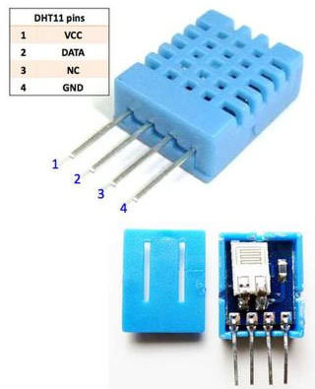
DH11 SENSOR
DHT11 is a Humidity and Temperature Sensor, which generates calibrated digital output.
DHT11 can be interface with any microcontroller like Arduino, Raspberry Pi, etc. and get instantaneous results.
By using the exclusive digital-signal-acquisition technique and temperature & humidity sensing technology, it ensures high reliability and excellent long-term stability.
This sensor includes a resistive-type humidity measurement component and an NTC temperature measurement component, and connects to a high performance 8-bit microcontroller, offering excellent quality, fast response, anti-interference ability and cost-effectiveness.

Slide 14
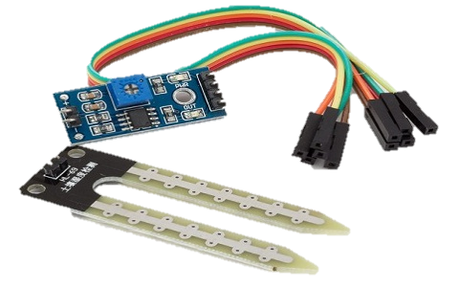
MOISTURE SENSOR
Soil moisture sensors measure the volumetric water content in soil.
As the straight gravimetric dimension of soil moisture needs eliminating, drying, as well as sample weighting.
These sensors measure the volumetric water content not directly with the help of some other rules of soil like dielectric constant, electrical resistance, otherwise interaction with neutrons, and replacement of the moisture content.
These sensors normally used to check volumetric water content, and another group of sensors calculates a new property of moisture within soils named water potential.

Slide 15
ADVANTAGES
Easy to implement.
Simple and efficient
Conserves water used for irrigation
Accurate sensing
Low maintenance cost
Acknowledging user about the field

Slide 16
APPLICATIONS
Agriculture.
Homes.
Industries.

Slide 17
REFERENCES
R. Nageswara Rao ; B. Sridhar, Year: 2018, “IoT based smart crop-field monitoring and automation irrigation system”, International Journal on Inventive Systems and Control ,pp: 478 – 483.
S. Vaishali ; S. Suraj ; G. Vignesh ; S. Dhivya ; S. Udhayakumar, Year: 2017, “ Mobile integrated smart irrigation management and monitoring systemusing IOT”, International Journal on Communication and Signal Processing ,pp: 2164 – 2167.
Shweta B. Saraf ; Dhanashri H. Gawali, Year: 2017, “ IoT based smart irrigation monitoring and controlling system”,IEEE International Journal on Recent Trends in Electronics, Information & Communication Technology ,pp: 815 – 819.
Pradorn Sureephong ; Patcharapong Wiangnak ; Santichai Wicha, Year: 2017, “The comparison of soil sensors for integrated creation of IOT-based Wetting front detector (WFD) with an efficient irrigation system to support precision farming”, International Journal on Digital Arts, Media and Technology ,pp: 132 – 135.
Kamel Ammour, Year: 2018 “Factory automation and irrigation control in an IoT environment”,Learning and Technology Journal ,pp: 120 – 128.
M. Mahalakshmi ; S. Priyanka ; S. P. Rajaram ; R. Rajapriya, Year: 2018,“ Distant Monitoring and Controlling of Solar Driven Irrigation Systemthrough IoT”,National Power Engineering Journal ,pp: 1 – 5.

Slide 18
THANK YOU

